Slide 1
Super Store Sales Dashboard
Created by Naishil Jhaveri

Slide 2
Project Overview
Tool: Microsoft Power BI
Dataset: Superstore Sales (Kaggle)
Objective: Analyze sales and profit performance across time, region, category, and customer segments.

Slide 3
Key KPIs
Total Sales: $1.57M
Quantity Sold: 22K units
Total Profit: $175K
Avg Ship Days: 22 days

Slide 4
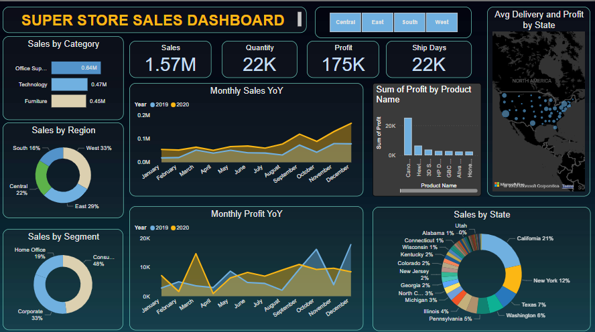
Dashboard Overview

Slide 5
Business Insights
West region contributes the highest sales (33%)
Office Supplies lead in category-wise sales
December sees a significant sales peak
California and Texas are top performing states by sales
Corporate and Consumer segments dominate customer base

Slide 6
Business Recommendations
Focus marketing efforts on high-performing regions (West, California, Texas)
Expand profitable product lines in Office Supplies and Technology
Target Home Office segment with promotions to boost engagement
Monitor December seasonal peak to ensure inventory readiness
Improve shipping logistics to reduce average ship days

